Slide 1
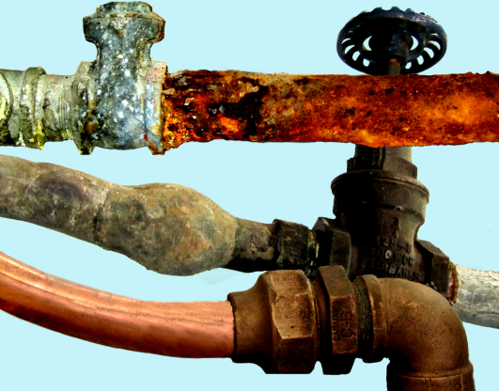
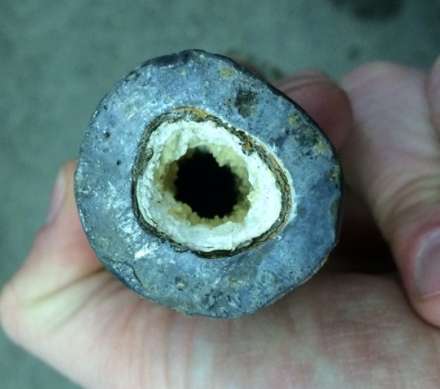

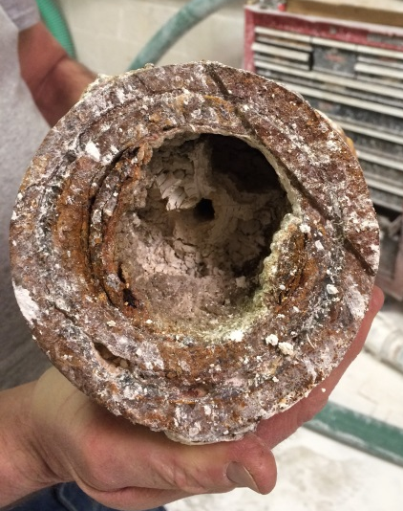
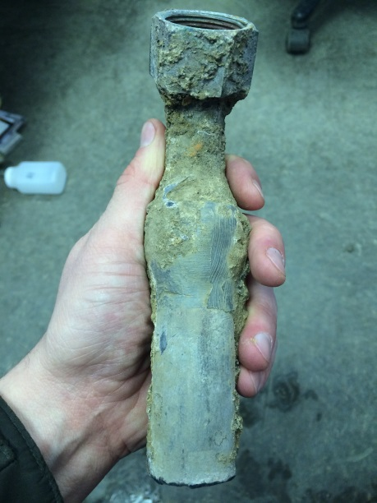
Mapping Lead Service Line Probability in Small Water Systems
Brian Beyeler, Ohio RCAP GIS Coordinator
Notes:
Image source
http://rapsplumbing.com/drain-cleaning-in-shelton-ct

Slide 2

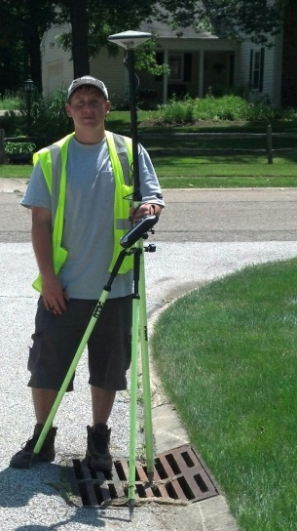
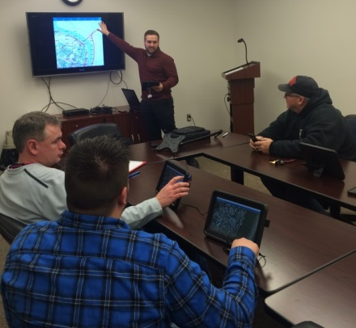
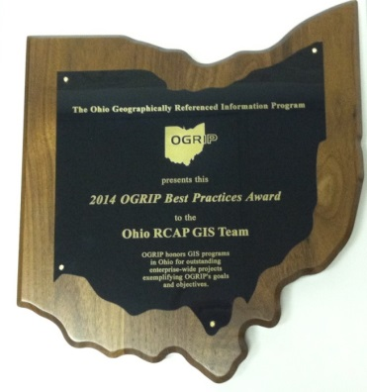
Cooperative founded in 2010
Makes GIS affordable for rural community utilities
Up to date GIS inventory, maps, web and mobile applications
Notes:
2 minutes - Background info on GIS team, data collection, and training etc.

Slide 3

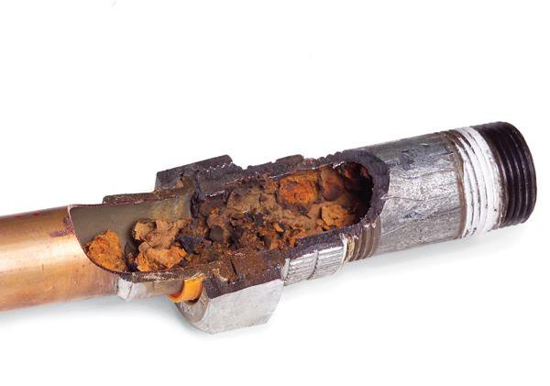
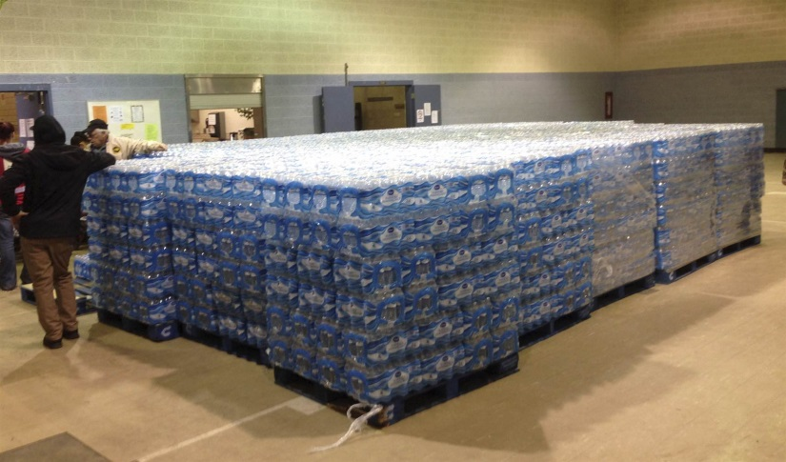
New Ohio EPA Lead (Pb) Rules
Lead and copper sampling
Map distribution systems
Identify all potential lead sources
Map public and private service lines
Description of buildings
Protection of residents
All public water systems were required to submit lead service line probability maps in March 2017, and updates will be required every five years.
Bottled water for distribution in Sebring, OH January 26 2016
Notes:
Image sources
https://www.familyhandyman.com/plumbing/plumbing-repair/join-galvanized-pipe-to-copper-pipe/view-all/
https://health.usnews.com/health-news/news/articles/2016-01-29/lawmakers-questioning-ohio-agency-over-lead-tainted-water

Slide 4
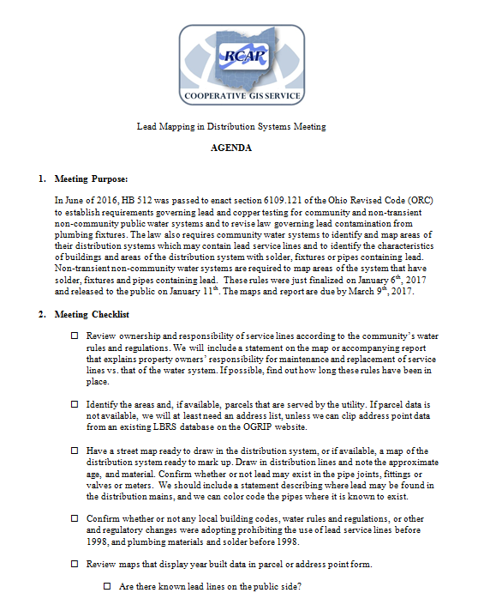
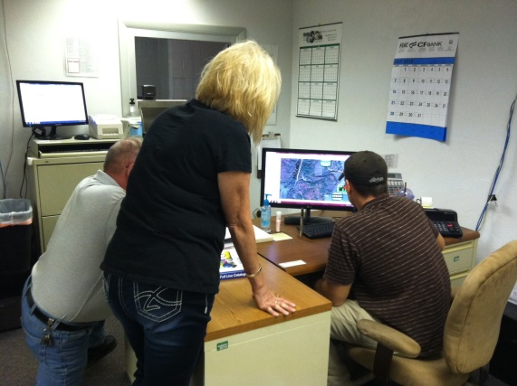
Process
Meet in person or via video conference
Complete interview questions
Review map with parcel or address data
Review records
Notes:
2 minutes Process before mapping

Slide 5
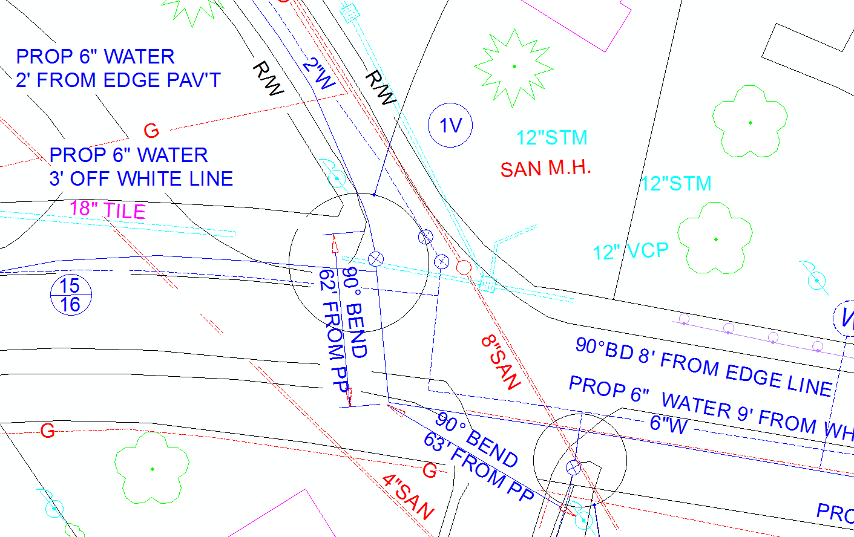
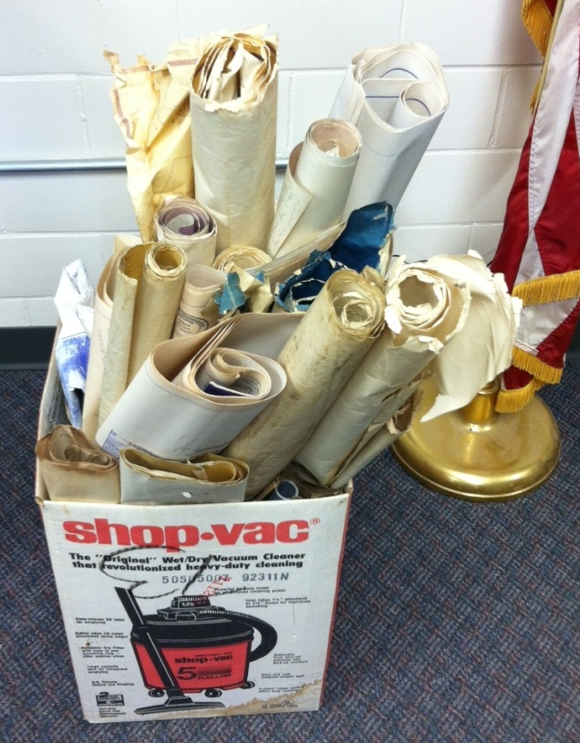
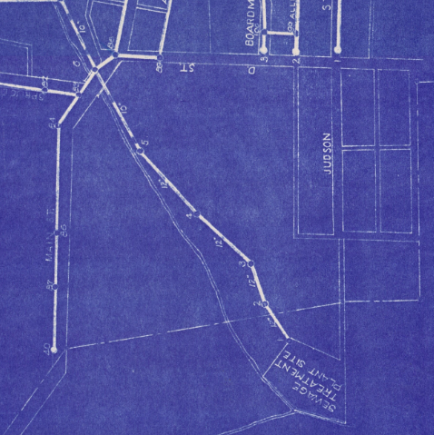
The Data Dilemma
Sources:
  As-builts/drawings
  Tap cards
  Operator knowledge
  Building permits
Reality:
  No records kept
  Operators are gone
  Plans are outdated
  Plans are destroyed
Notes:
Image Source
Street Engineering St Clairsville, OH

Slide 6
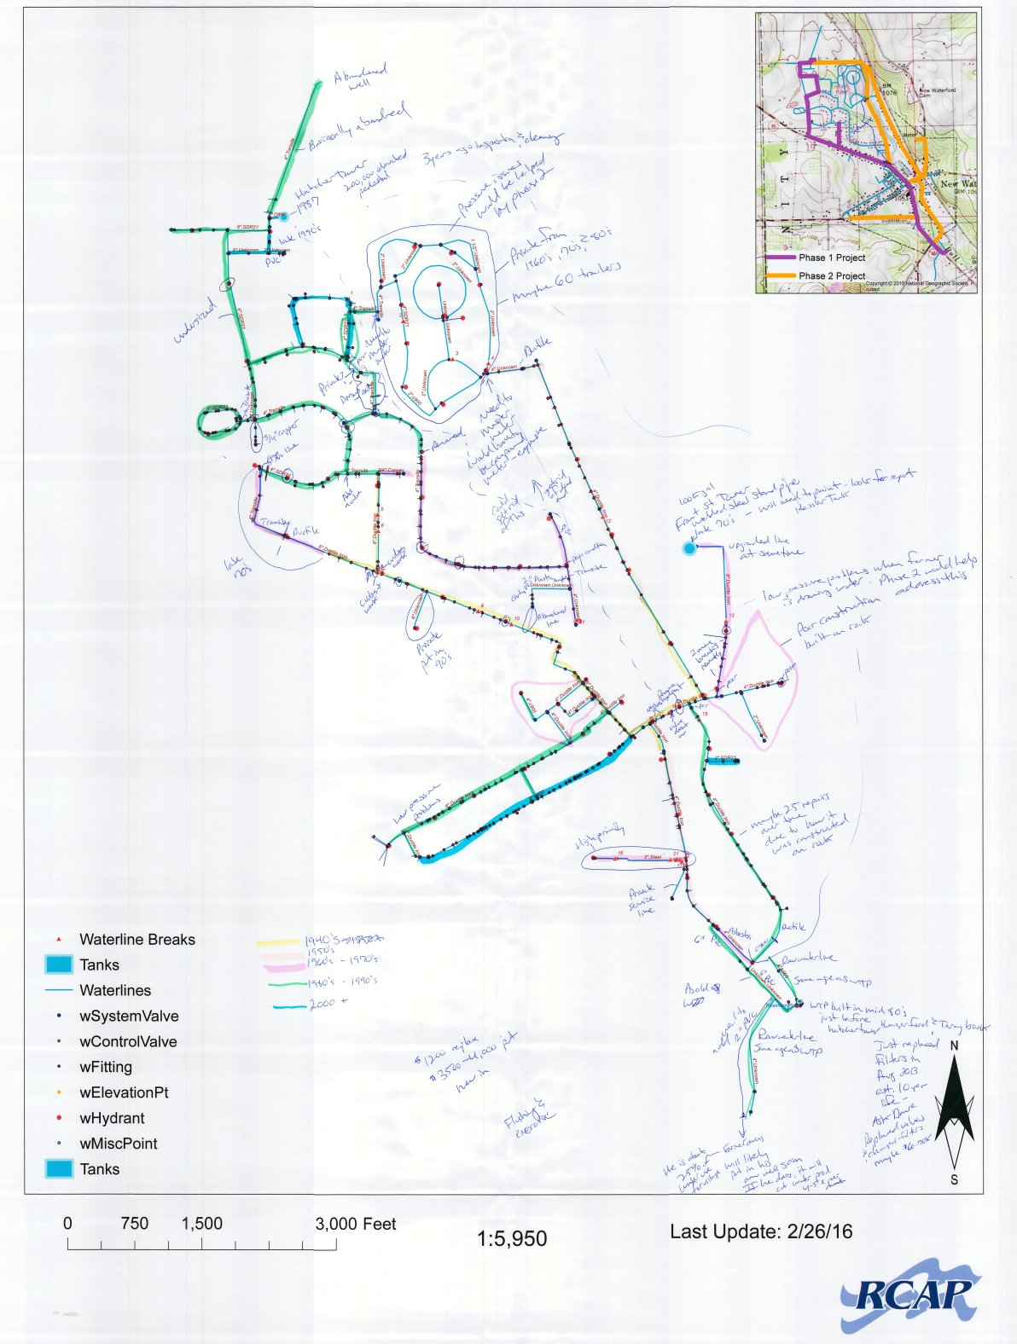

Pipe material and age identification
Notes:
1 minute go Lack of data go through date pipes, age of mains most times determin system owned side age

Slide 7
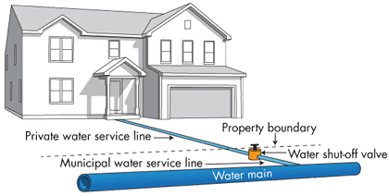
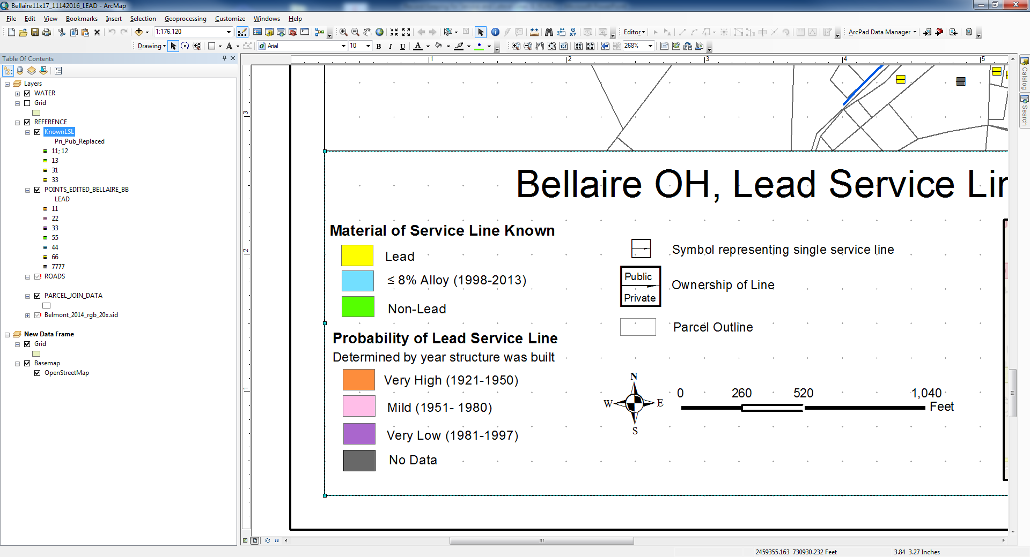
Ownership & Responsibility
Notes:
Image source
https://cdn.ymaws.com/www.isawwa.org/resource/collection/E93C6395-D2E9-4FE4-94B1-174E2376BEEC/March_16-webinar-Schools_(004).pdf

Slide 8
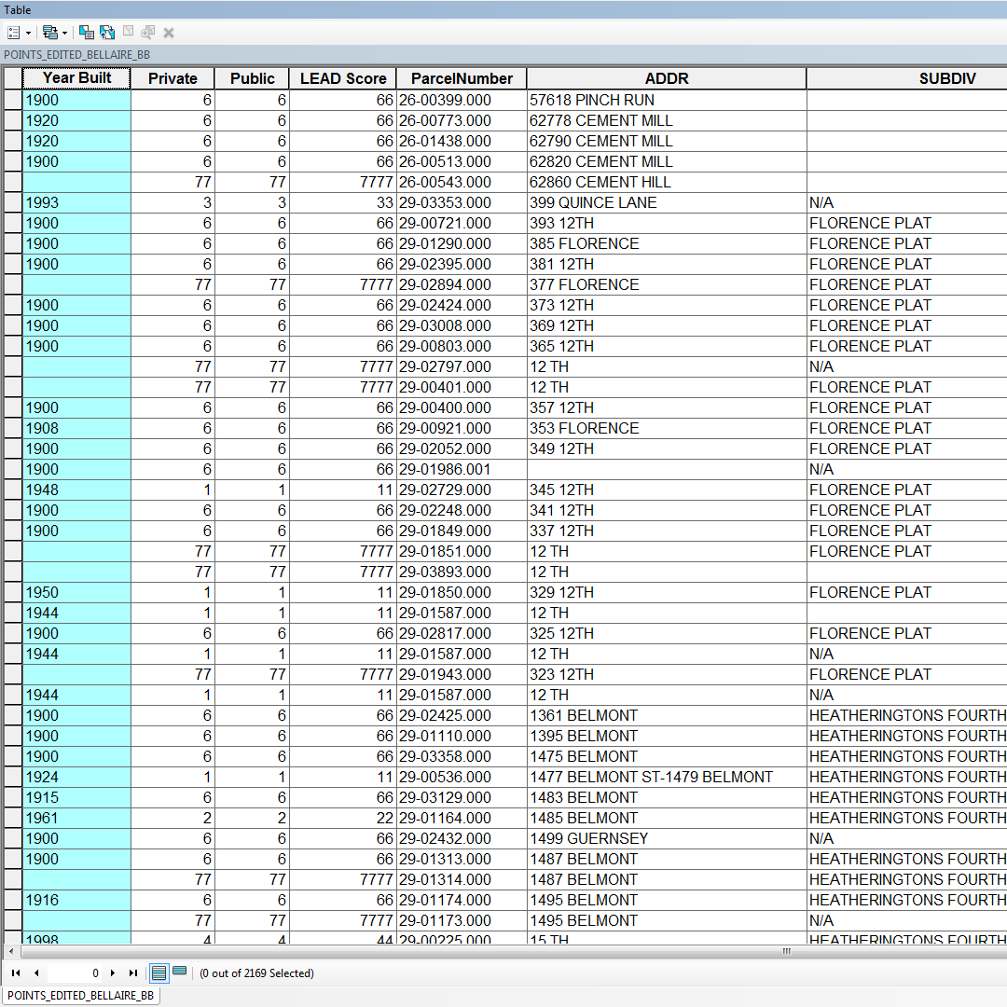
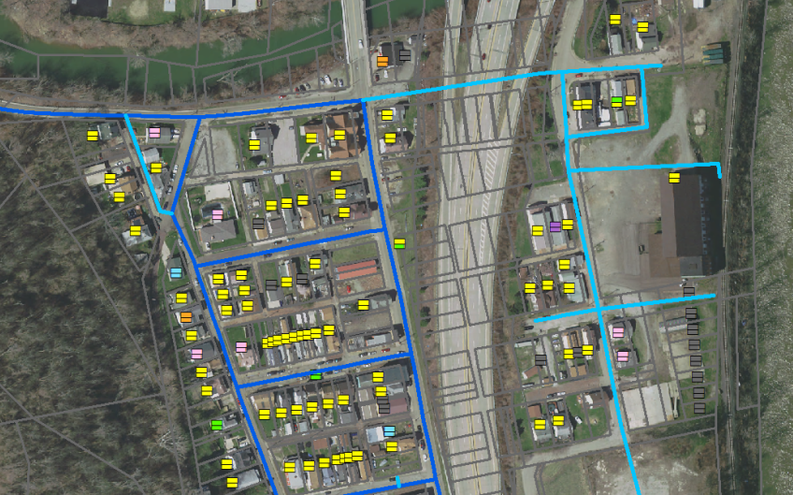
Filling in the Gaps
Find Data
Join data to GIS
Symbolize by year built
Assign value to known
Assign probability value to unknown

Slide 9
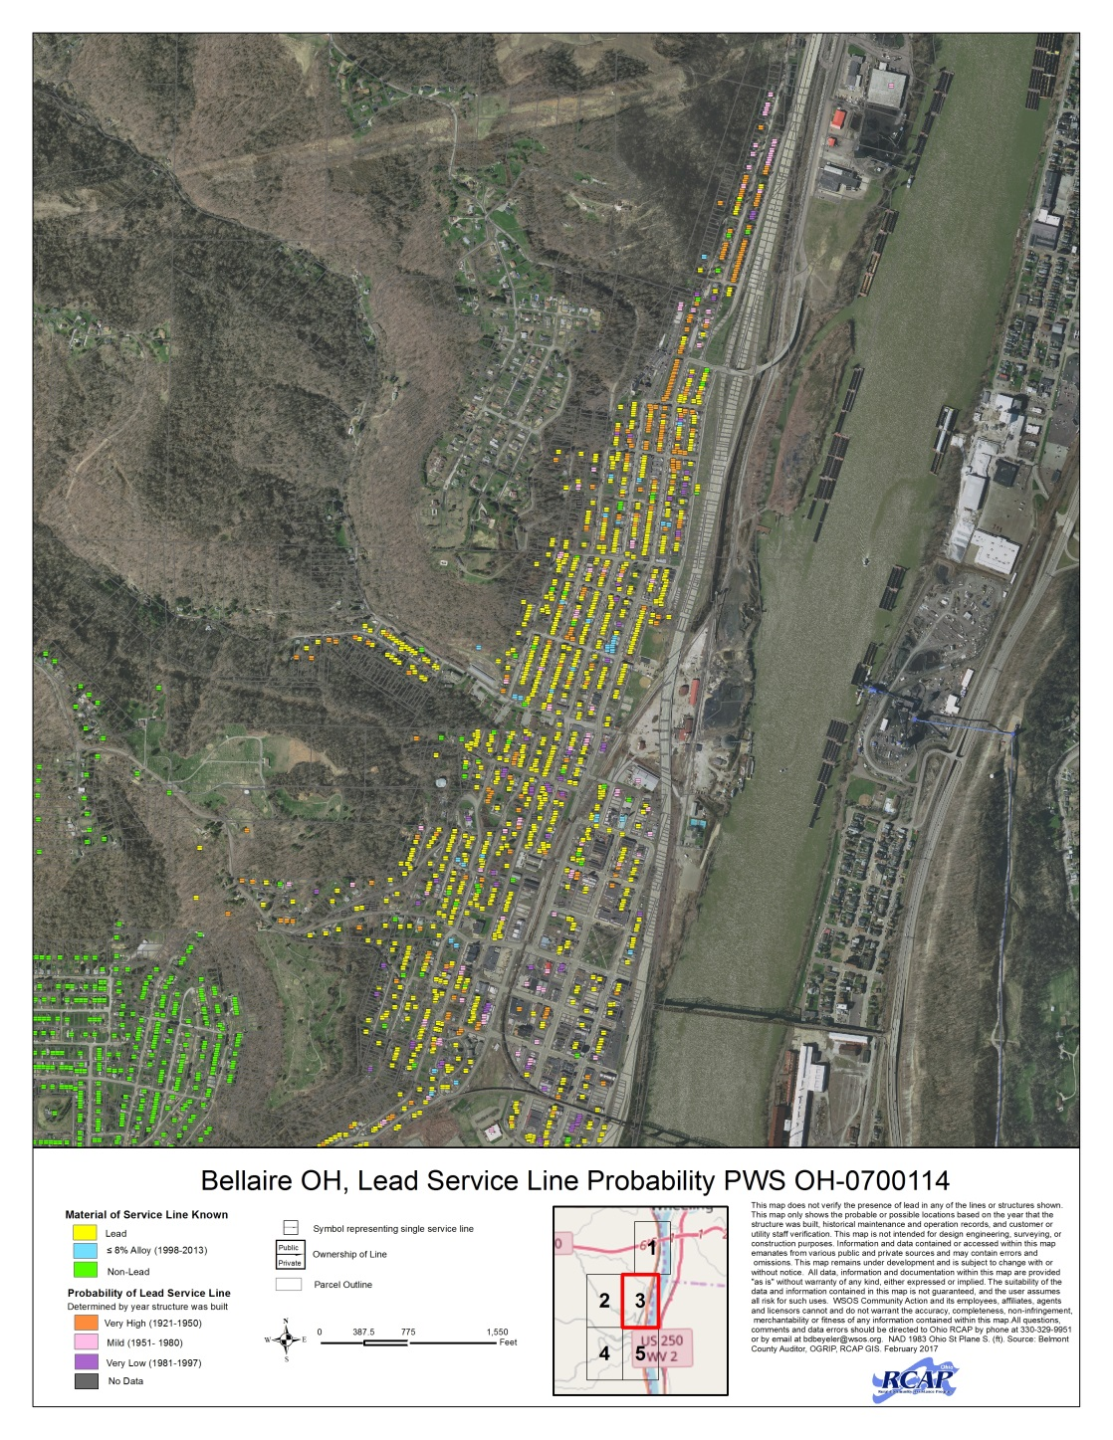
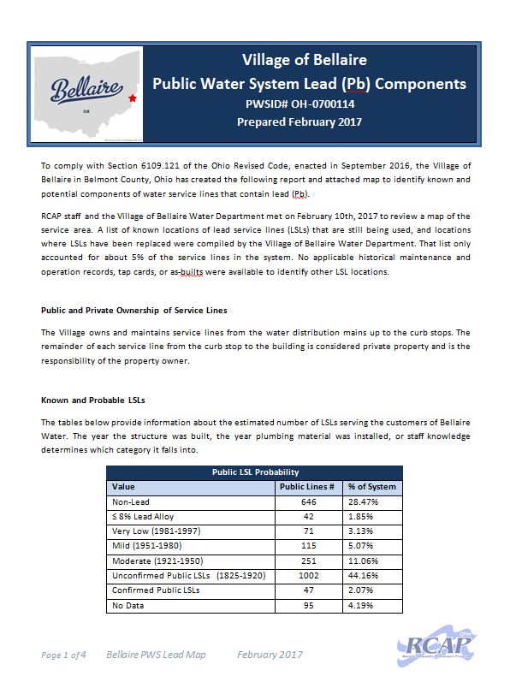
Result
Maps and reports for 51 public water systems

Slide 10
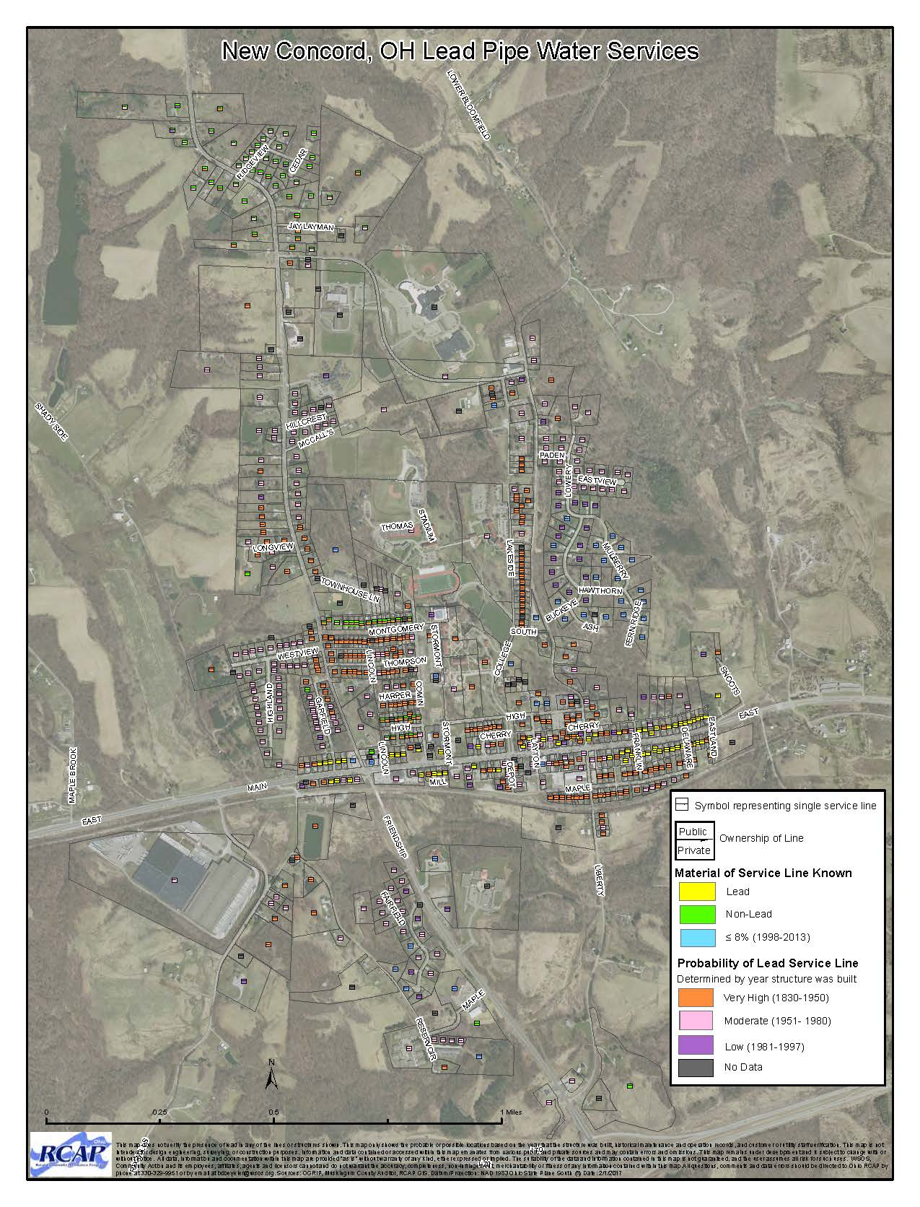
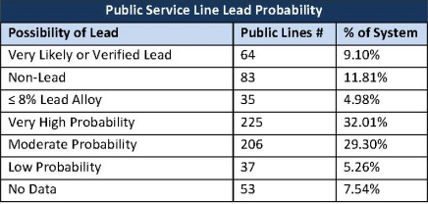
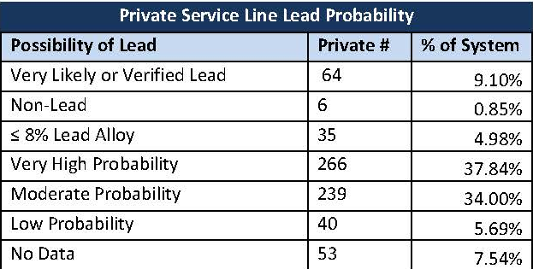
Results
Notes:
1

Slide 11
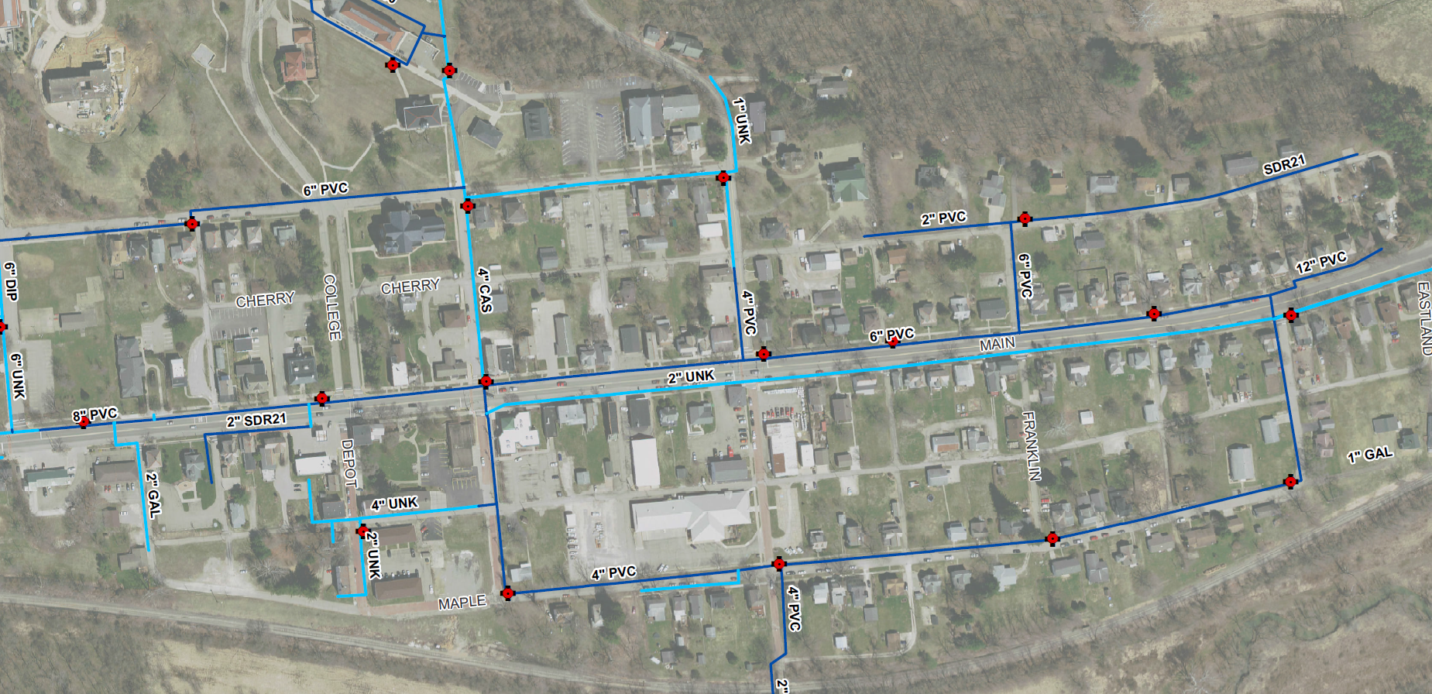
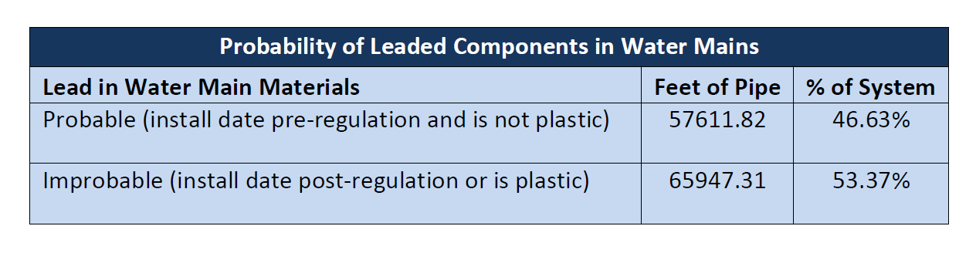
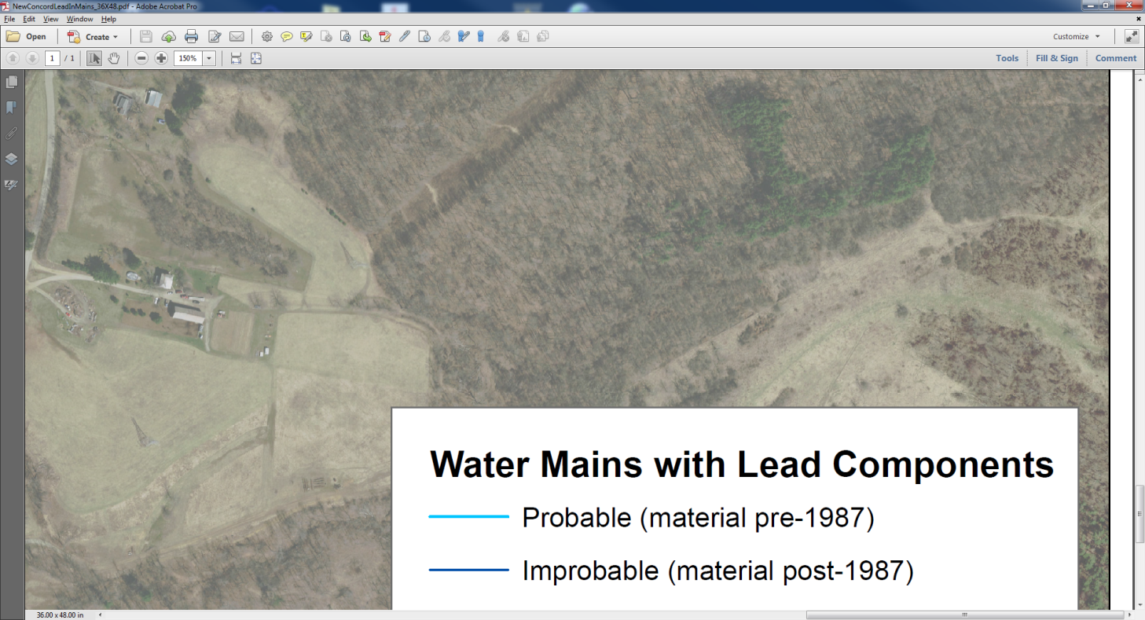
Main Line Leaded Components

Slide 12
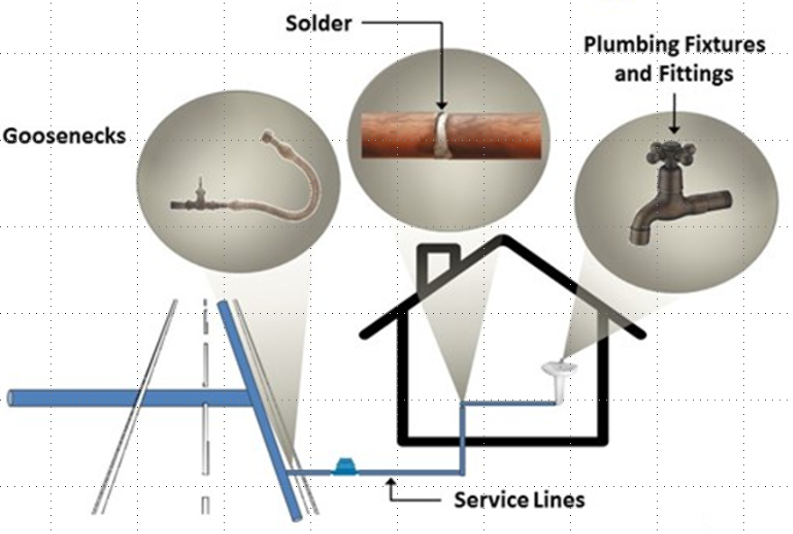
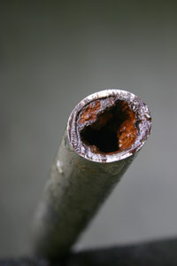
Other Sources of Lead
Notes:
Image source
https://www.owasa.org/lead-copper-and-drinking-water

Slide 13

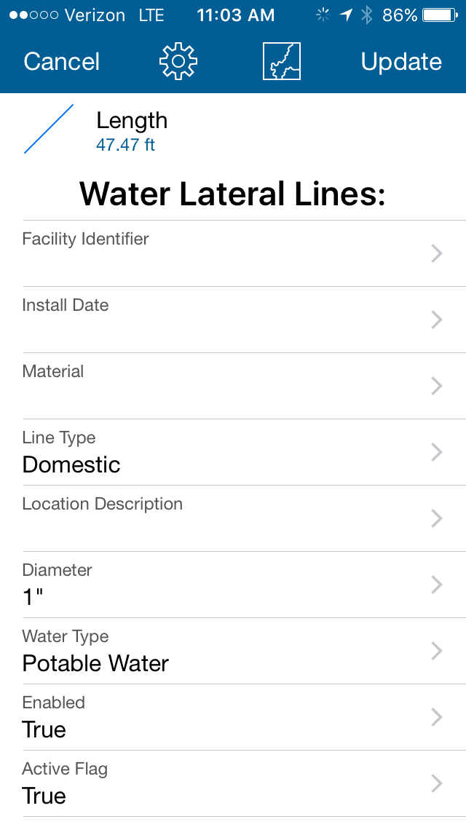
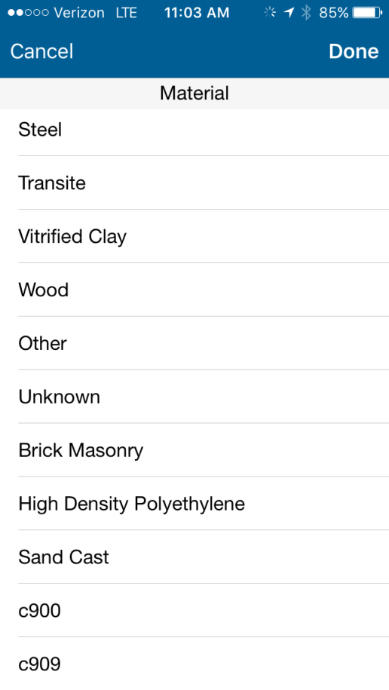

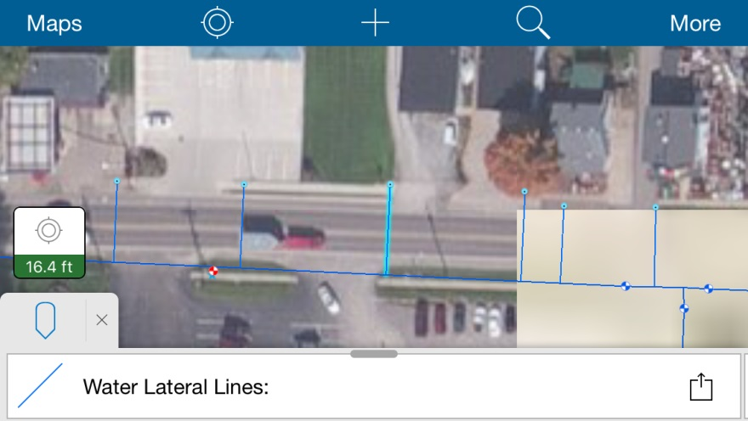
Updating Service Lines with Mobile Apps
Collector Application
Notes:
2

Slide 14
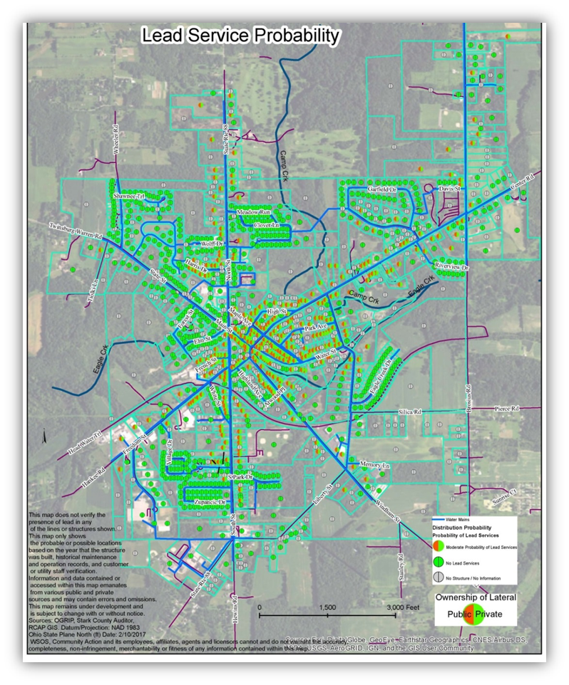
Questions?

Slide 15


Thank You
Contact Information
Brian Beyeler, GIS Coordinator
330-329-9951 bdbeyeler@wsos.org
David Garretson, GIS Database Administrator
330-715-5371 dkgarretson@wsos.org
Sherry Loos, GISP, Ohio RCAP State Coordinator
330-677-3438 smloos@wsos.org
RCAP General Website - http://rcap.org
WSOS Community Action - http://wsos.org

